Slide 1
Web Application Development II
Week 6: Vue.js Modularizatoin with Components

Slide 2

Agenda
Introduction to Components
Defining a Component
Registration and using a component
Dynamic properties
Passing data to component
Persisting data with Local Storage

Slide 3
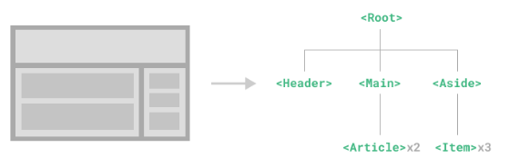
Components
Components allow us to split the UI into independent and reusable pieces, and think about each piece in isolation. It's common for an app to be organized into a tree of nested components.
This is very similar to how we nest native HTML elements, but Vue implements its own component model that allows us to encapsulate custom content and logic in each component.

Slide 4
Naming Convention
It is recommended to use PascalCase for ComponentNames <PascalCase /> to differentiate from native HTML elements.
PascalCase names are valid JavaScript identifiers (kebab-case names are not). This makes it easier to import and register components in JavaScript. It also helps IDEs with auto-completion.
On the other hand, a component registered as MyComponent can be referenced inside a Vue template via both <MyComponent> and <my-component>.

Slide 5
Defining a Component
Using Composition API, we can define each Vue component in a dedicated file using the .vue extension - known as a Single-File Component (SFC for short):
Example: components/ButtonCounter.vue
ChildComponent.vue
<script setup>
import { ref } from 'vue'
const count = ref(0)
</script>
<template>
<button @click="count++">You clicked me {{ count }} times.</button>
</template>

Slide 6
Using a Component
To use a child component, we need to import it in the parent component.
Components can be reused as many times as you need
Example: views/Example1View.vue
ParentComponent.vue
<script setup>
// naming convention: PascalCase
import ButtonCounter from '../components/ButtonCounter.vue'
</script>
<template>
<!– can use kebab case or PascalCase in template -->
<!-- <buttoncounter /> --> <!-- this does not work -->
<ButtonCounter /> <!– PascalCase -->
<button-counter /> <!– kebab-case -->
</template>

Slide 7
src/components/ vs src/views/
Now that you are learning about components, it is now a good time to make use of views/ folder in our Vue SPA setup.
Notice in our example folder in this week that we now place example files in views/ folder.
Rule of Thumb:
If it is a page that has a URL, put it in views/
If it is a piece of UI you can reuse, put it in components/
src/components/ – reusable building blocks
It stores reusable UI components that can be used in many places across the app, e.g., NavBar.vue, Header.vue, Footer.vue, PostCard.vue, etc.
src/views/ – route-level pages (screens)
It stores page/view components that represent full screens in your SPA, usually mapped via Vue Router routes (router/index.js)
E.g., HomeView.vue, PostsView.vue, LoginView.vue, etc.

Slide 8
Template
template serves as the markup for the Vue component
Example: components/ButtonCounter.vue
<template>
<p>If you like my page, click </p>
<button @click="count++">Like</button>
<p>People liked me {{ count }} times.</p>
<p v-if="count>2"> I am POPU-LAR.</p>
</template>
Intuitively, the template is used to replace the component-element.
<ButtonCounter />

Slide 9
Passing Props (1)
Props are custom attributes that are exposed to accept data from the parent component.
For example, if you are creating a custom card, the card will need the content (text data) from the parent component, so that the cards can have the same visual layout but with different content.
A component can have as many props and value of various data type can be passed to the props.
To use Props, you need to register on the component using defineProps
Example: components/Product.vue
  <script setup>
  const props = defineProps([‘name’, ‘price])
  console.log(props.name)
  </script>
  <template>
  <h3>Product: {{ name }}</h3>
  </template>
props are (custom) HTML attributes

Slide 10
Passing Props (2)
Once a prop is registered, you can pass data to it as a custom attribute from parent component
Example: views/Example2View.vue
  <script setup>
  import Product from
  ‘../components/Product.vue’
  </script>
  <template>
  <product name=“iPhone’ price=‘100’ />
  </template>
props are (custom) HTML attributes

Slide 11
Passing Props (3)
In addition to declaring props using an array of strings, we can also use the object syntax
The key is the name of the prop
The value is the expected data type, e.g., Object, String, Number, Boolean
Naming convention when declaring a prop: camelCase
Example
ChildComponent.vue
<script setup>
const props = defineProps({
greetingMessage: String
})
console.log(props.greetingMessage)
</script>
<template>
<div v-html=‘greetingMessage'></div>
</template>
accessing a prop

Slide 12
Passing Props (4)
But to align with HTML attributes, naming convention when using a prop: kebab-case
Example
ParentComponent.vue
<script setup>
import ChildComponent from ‘../components/ChildComponent.vue’
</script>
<template>
<ChildComponent greeting-message="hello" />
</template>

Slide 13
Accessing Props
In JavaScript context, you can access the props via props.<propname>
In HTML context (template), you can access the props just like accessing a JavaScript variable
Example: components/Product.vue
  <script setup>
  const props = defineProps([‘name’, ‘price])
  console.log(props.name)
  </script>
  <template>
  <h3>Product: {{ name }} </h3>
  </template>
accessing a prop

Slide 14
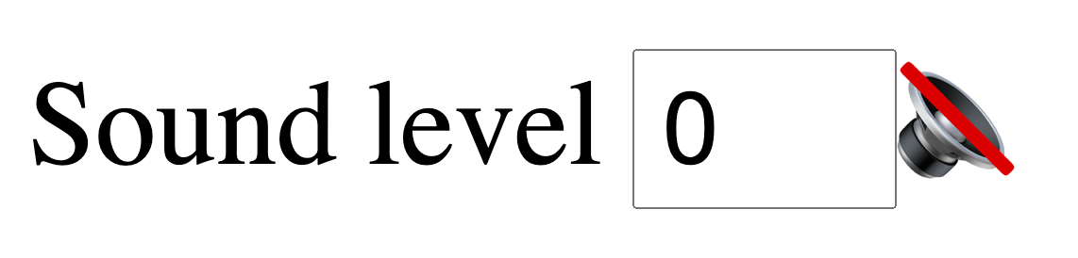



Exercise 1
In this exercise, we would like to define a component for displaying “Sound Level”.
Given Ex1View.vue and SoundIcon.vue, complete the TODO such that when the user enters a value between 0 and 3, a corresponding sound-level icon appears on the right.
Be mindful how values are passed around.

Slide 15
Dynamic Properties (1)
In a typical app, you may need to pass an array of data from your parent component.
In this case, use v-for and v-bind
Example: views/Example3View.vue
// use component
const products = ref([
{ id: 1, name: 'iPhone’,
desc: '<p>This is the best phone in the world!</p>' },
{ id: 2, name: 'Samsung’,
desc: '<p>No, mine is the best!</p>' },
{ id: 3, name: 'Oppo’,
desc: '<p>Mine is cheaper and yet as good!</p>' }
])
====
<Product
v-for="product in products"
v-bind:key="product.id"
v-bind:prod="product"
/>
Note that when using v-for, it is recommended to bind the key attribute with a unique value, so that Vue can correctly track each node based on the unique value.
Refer to this for detail

Slide 16
Dynamic Properties (2)
Notice in previous slide how v-bind:prod=“product” is used to pass dynamic prop values.
This is useful when you don’t know the exact content you are going to render ahead of time, i.e., dynamic data
Dynamic data may be obtained from user or Asynchronous requests
Example: components/Product2.vue
// define component
<script setup>
const props = defineProps({
prod: Object
})
</script>
<template>
<h3> {{ prod.id }} : {{ prod.name }} </h3>
</template>
Notes:
Maintaining State with key​
When Vue is updating a list of elements rendered with v-for, by default it uses an "in-place patch" strategy. If the order of the data items has changed, instead of moving the DOM elements to match the order of the items, Vue will patch each element in-place and make sure it reflects what should be rendered at that particular index.
This default mode is efficient, but only suitable when your list render output does not rely on child component state or temporary DOM state (e.g. form input values).
To give Vue a hint so that it can track each node's identity, and thus reuse and reorder existing elements, you need to provide a unique key attribute for each item:

Slide 17
Passing Content via Slot
Just like with HTML elements, it’s often useful to be able to pass content to a component.
This can be done with <slot> element.
Use named-slots when there are multiple slots.
Example: Example4View.vue, AlertBox.vue, Book.vue
// define (AlertBox.vue)
<div class=“alert”>
<slot></slot>
</div>
// use (Example4.vue)
<alert-box>
check it out!
</alert-box>
Parent template
Child template
Named Slots:
<div>
<slot name=‘slotA’></slot>
<slot name=‘slotB’></slot>
</div>
<alert-box>
</alert-box>
  <div class=“alert”>
  </div>
check it out!
<slot></slot>

Slide 18
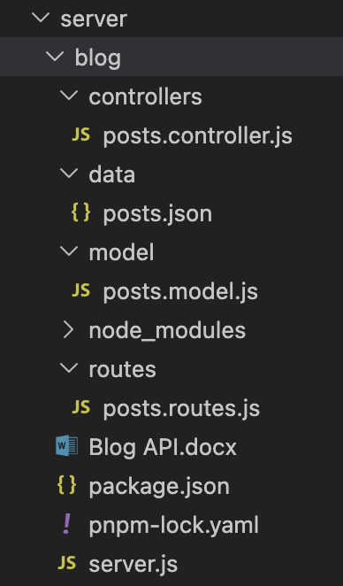
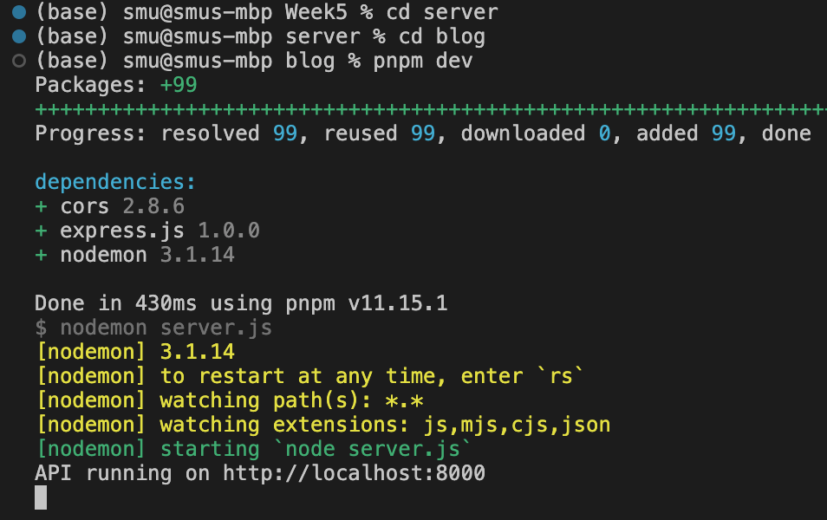
(Week5) Running example: A Blog Service (1)
Set up a blog backend service using Node.js + Express.js
These technologies are covered in WAD1.
Download server.zip and unzip into a folder, say server. It contains a folder ‘blog’ which is a blog backend app.
In the terminal, run the following commands to launch this backend service
cd server/blog
pnpm install
pnpm dev

Slide 19
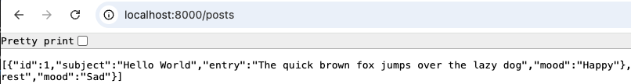

(Week5) Running example: A Blog Service (2)
3. In the browser, run the URL: http://localhost:8000/posts
You should observe the JSON data returned by the blog service.
4. This blog service provides a few APIs. Some of them are:
retrieve all posts: GET /posts
retrieve post with a given id: GET /posts/:id
create a new post: POST /posts
update an existing post with a given id: PUT /posts/:id
delete an existing post with a given id: DELETE /posts/:id
Example retrieve post with a given id =>

Slide 20
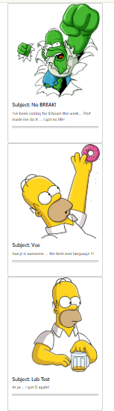
Exercise 2
Given Ex2View.vue and BlogPost.vue, complete the TODO so that the posts are displayed using ‘BlogPost’ components.
Hint:
  three images are provided under the folder /src/assets/ for different moods.
  Use computed property to bind the image source

Slide 21
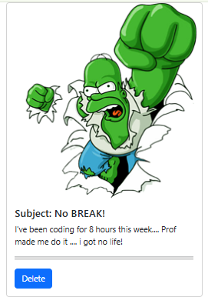
Exercise 3
After completing Ex2View.vue in Exercise 2, add a ‘delete’ button for each post such that the post can be deleted using the deletePost service given in “blog” application (i.e.,
send Asynchronous DELETE request to http://localhost:8000/posts/:id
with the blog ‘subject’ parameter)
Hint:
Use slot to add the button
Use Axios delete method
  axios.delete(url, { data: { subject: subject } })

Slide 22
Emitting Events (1)
Sometimes the nodes (childs) in the component may need to communicate to the parent, such as ‘emit an event’
Suppose we have a button in a component. On clicking the button, it wants to enlarge the text. So the component needs to declare that it will emit events using defineEmits()
Naming convention for event name: same as ‘props’
Example: Product3.vue
const emit = defineEmits(['enlarge', 'shrink'])

Slide 23
Emitting Events (2)
We can emit an event either inline or inside a function
For inline emitting, use $emit to emit a custom event
Example: Product3.vue
<div class='product’>
<h3>{{ prod.name }}</h3>
<button v-on:click="$emit('enlarge')">
Enlarge text
</button>
<div v-html='prod.desc'></div>
</div>

Slide 24
Emitting Events (3)
We can emit an event either inline or inside a function
For emitting an event inside a function, use the returned emit instance from defineEmits()
Example: Product3.vue
<script>
const emit = defineEmits(['enlarge', 'shrink'])
function doShrink() {
emit('shrink')
}
</script>
<template>
<button v-on:click="doShrink">
Shrink text
</button>
</template>

Slide 25
Listening to Events (1)
Similar to listening to HTML events, the parent component can listen to the (custom) events emitted by the child component(s) it uses.
Example: Example5View.vue
<template>
<div :style="{ 'font-size': fontSize + 'em' }">
<Product v-for="product in productData“
:key="product.id” :prod="product"
@enlarge="fontSize += 0.1"
@shrink="fontSize -= 0.1"
/>
</div>
</template>

Slide 26
Event Arguments (1)
It is sometimes useful or necessary to emit a specific value with an event.
For example, we may want the <Product> component to be in charge of how much to enlarge the text by.
In those cases, we can pass an extra argument to provide this value:
Example: Product4.vue
<div class='product’>
<h3>{{ prod.name }}</h3>
<button v-on:click =
“$emit('enlarge’, 0.1)">
Enlarge text </button>
<div v-html='prod.desc'></div>
</div>

Slide 27
Event Arguments (2)
It is sometimes useful or necessary to emit a specific value with an event.
For example, we may want the <Product> component to be in charge of how much to enlarge the text by.
In those cases, we can pass an extra argument to provide this value:
Example: Product4.vue
// emit event from a function
function doShrink() {
// notice the use of object as emitted data
emit('shrink', { amount: 0.1 })
}

Slide 28
Listening to Events (2)
Example: Example6View.vue
function onEnlarge(enlargeAmount) {
fontSize.value += enlargeAmount
}
function onShrink(shrink) {
fontSize.value -= shrink.amount
}
====
<div :style="{ 'font-size': fontSize + 'em' }">
<Product v-for="product in products"
:key="product.id" :prod="product"
@enlarge="onEnlarge“ @shrink="onShrink"
/>
</div>
Similar to listening to HTML events, the parent component can listen to the (custom) events emitted by the child component(s) it uses.
It can also retrieve the emitted value inside the handler function:

Slide 29
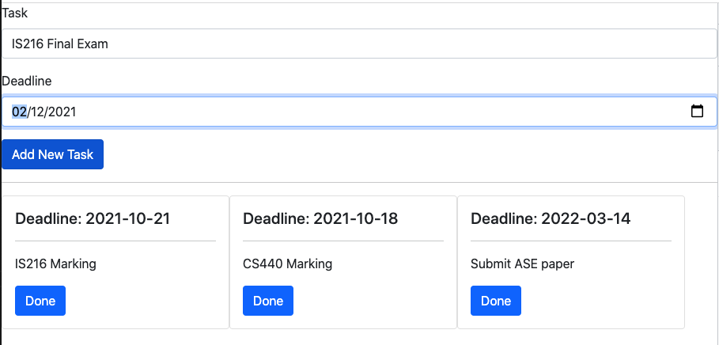
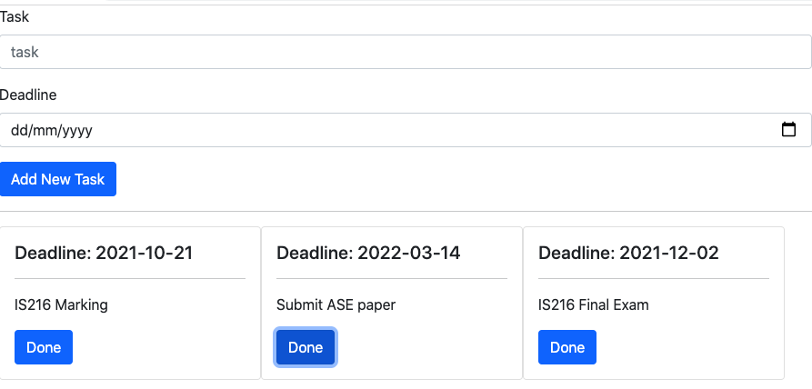
Exercise 4
Add/modify code in Ex4View.vue and TaskTracker.vue such that when the user enters a new task and deadline and click “Add New Task”, it displays the newly-entered task in the web page.
When the user clicks “Done”, the task is removed.
You must use the given TaskTracker component to implement the function described above.
Hint: Use $emit to generate events from component; use Bootstrap Card.

Slide 30
Global Registration
In our previous examples, components are imported only locally, i.e., a parent component imports a child component to be used in its local template.
We can also make components available globally using .component() method
Globally registered components can be used in the template of any component within the application
Example: main.js, App.vue, HomeView.vue
import ComponentA from ‘./components/ComponentA’
import ComponentB from ‘./components/ComponentB’
import ComponentC from ‘./components/ComponentC’
app.component(‘ComponentA’, ComponentA)
app.component(‘ComponentB’, ComponentB)
app.component(‘ComponentC’, ComponentC)
=====
<!-- this will work in any component inside the app -->
<ComponentA />
<ComponentB />
<ComponentC />

Slide 31
Persisting Data with Local Storage (1)
Sometimes, a client app like Vue.js application needs to save and load app state locally (in the client’s machine).
For example, to persist data across page refresh, browser restart, remember UI preferences such as dark mode, language, etc.
Note: avoid storing sensitive data such as passwords, API keys in localStorage as any JS on the page can read it
Example: Example7View.vue
Methods:
localStorage.getItem(key) returns string | null
localStorage.setItem(key, value) stores strings only
localStorage.removeItem(key) removes the storage under the given key
onMounted() is a good place to load initial values

Slide 32
Persisting Data with Local Storage (2)
Modern browser provide a local storage mechanism using key-value pairs (both stored as strings).
Scope: per origin (same protocol + domain + port), e.g., http://localhost:5173
Example: Example7View.vue
Methods:
localStorage.getItem(key) returns string | null
localStorage.setItem(key, value) stores strings only
onMounted() is a good place to load initial values

Slide 33
Persisting Data with Local Storage (3)
localStorage only supports “string”. If you wish to save an object or an array, use JSON.stringify and JSON.parse to serialize and deserialize object/array
Serialization is the process of converting object/array into a standardized, portable format (like text) so it can be stored or transmitted. Deserialization is the exact reverse process.
Example
const obj = { name: “Jack” }
// save data
localStorage.setItem( key, JSON.stringify(obj) )
// load data
const data = JSON.parse( localStorage.getItem(key) )

Slide 34
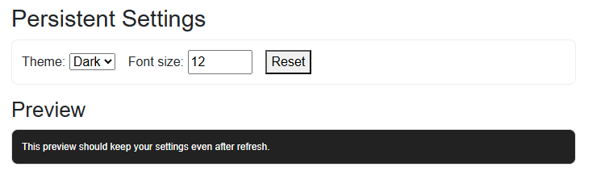
Exercise 5
Add/modify code in Ex5View.vue and SettingPanel.vue to persist an object { theme, fontSize } in localStorage using event handlers.
Requirements:
Save settings whenever the user changes:
  Theme dropdown (@change)
  Font size input (@input or @change)
Load settings on startup using onMounted
Reset clears both UI state and localStorage

Slide 35
Take Away Message
Define reusable templates as components.
Use props, slots to pass data to components.
Use $emit and custom events, with argument, to pass data from component back to its parents.
Use localStorage mechanism provided by Modern browsers to persist (non-sensitive) data such as user preferences

